Slide 1

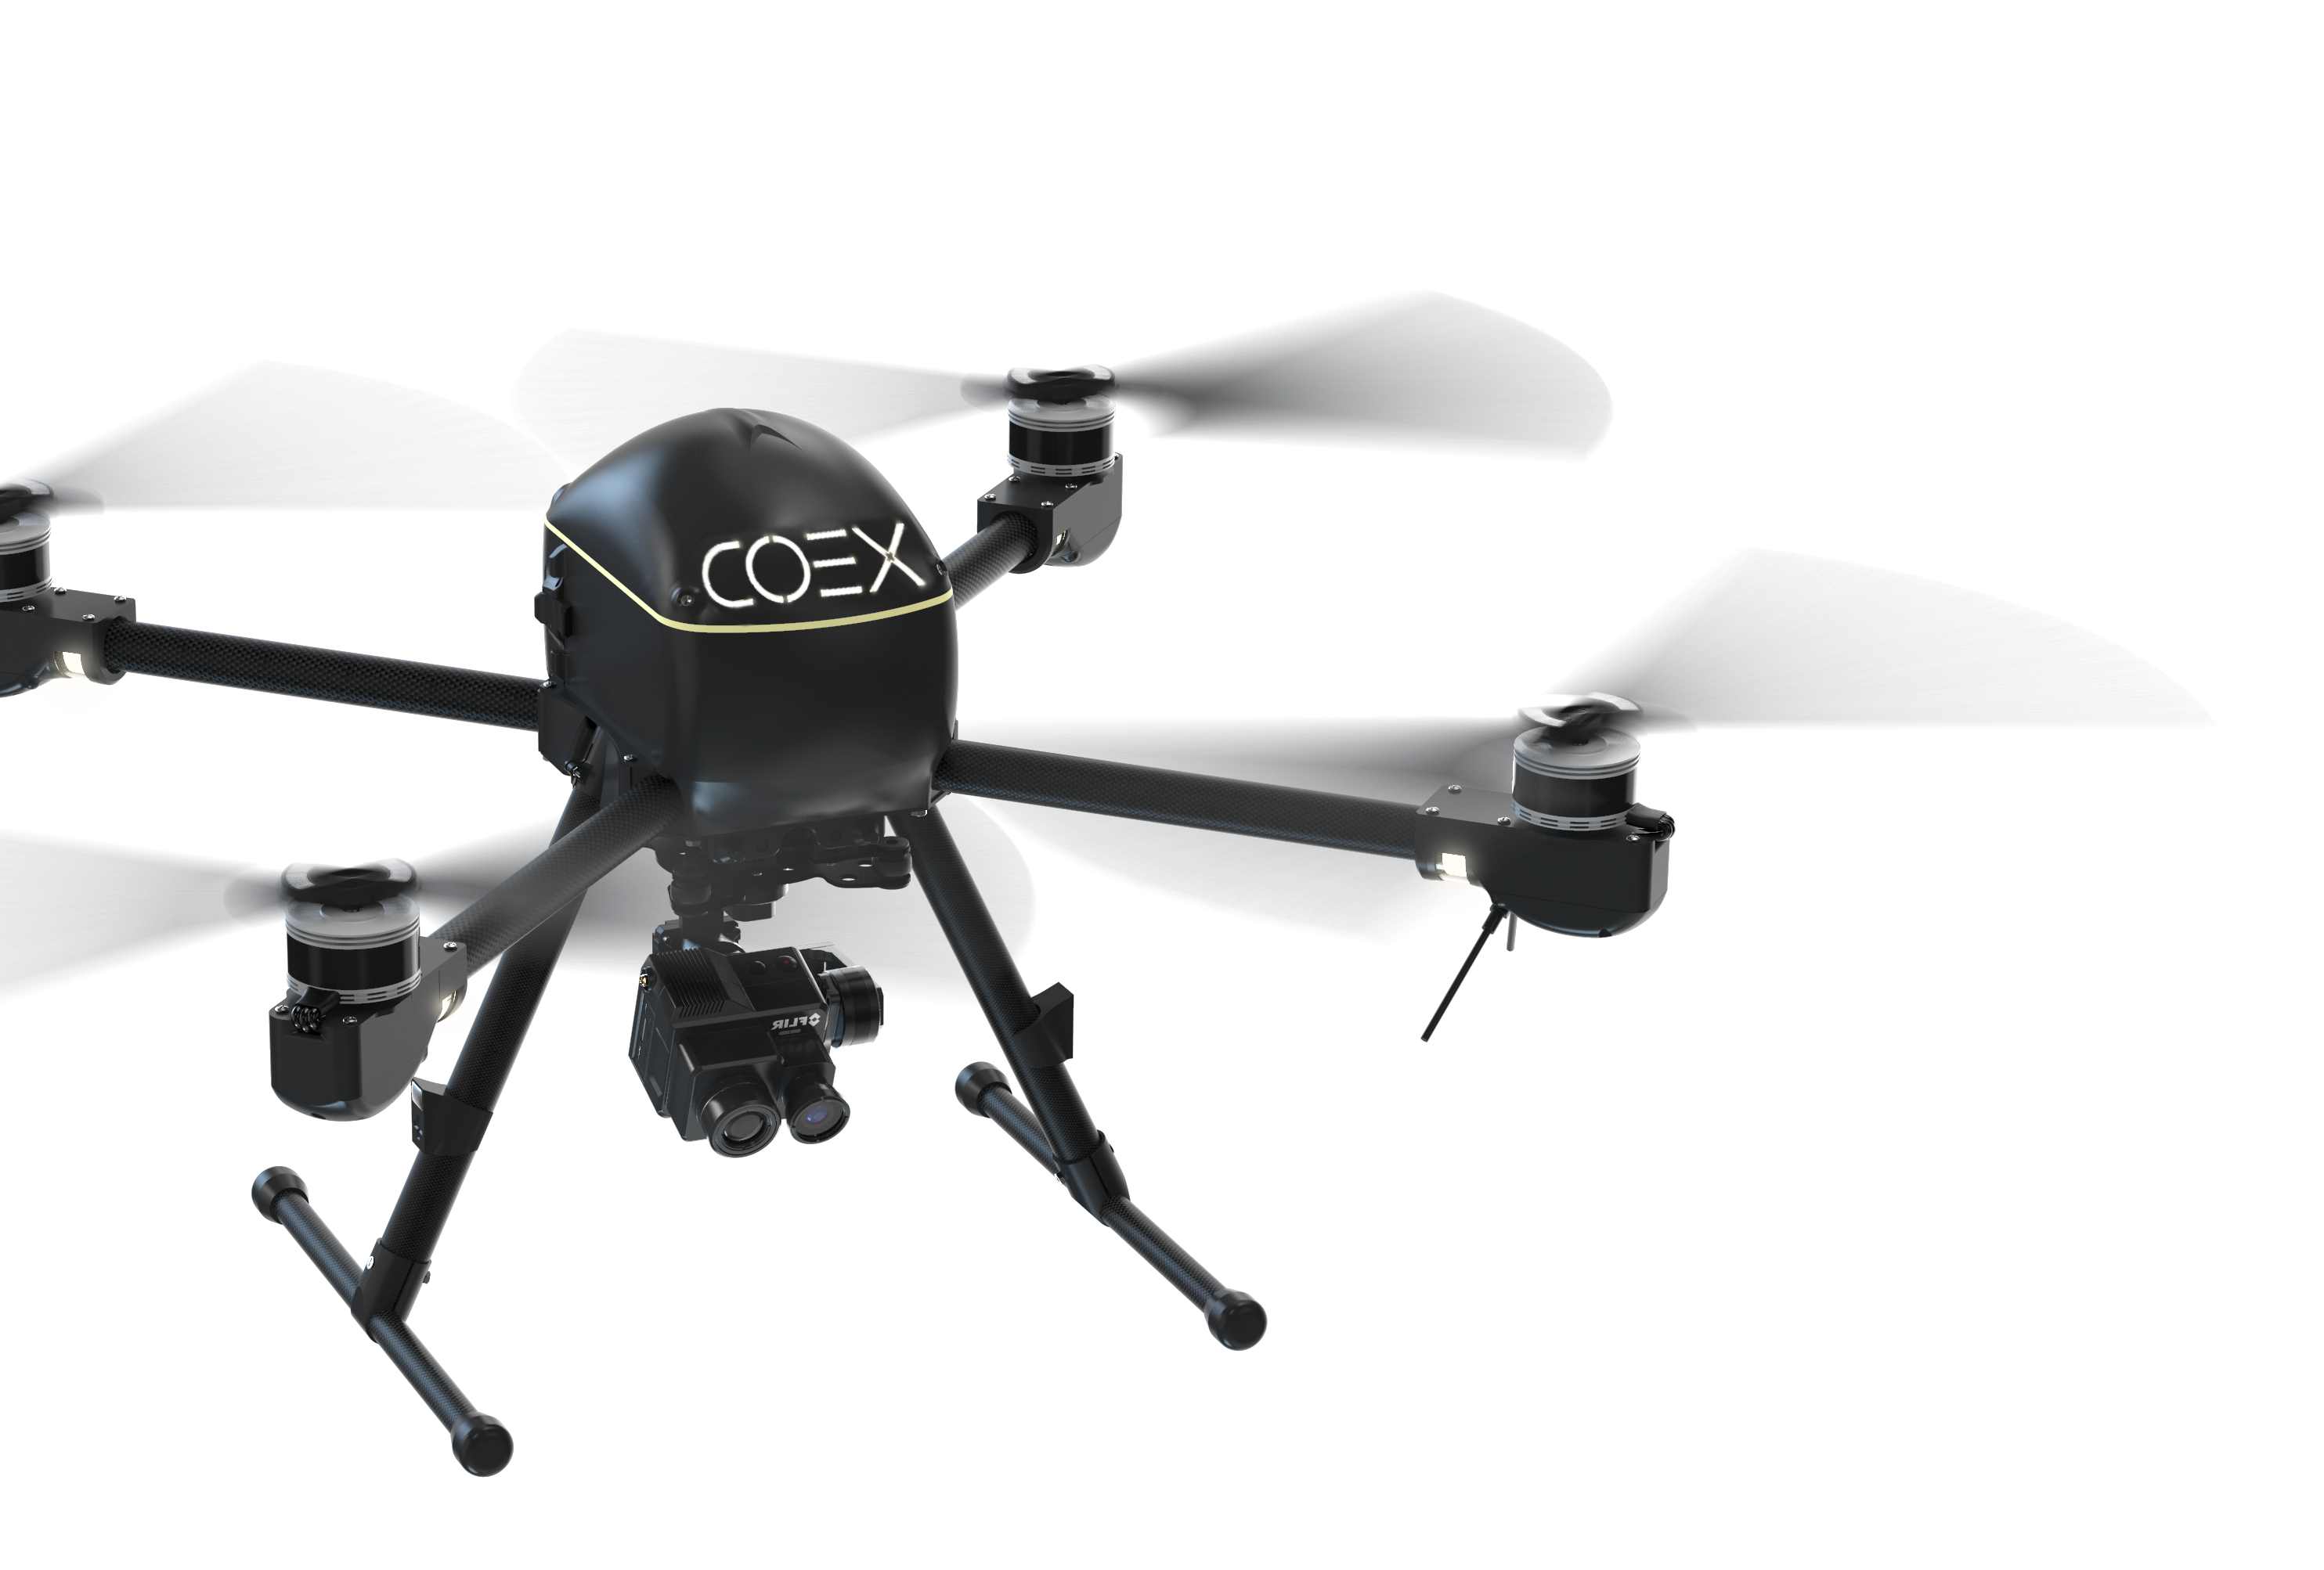

VIRUS
VS
coex.tech
ili@coex.tech
DRONES AS CITY SERVICE, PROVIDING DAY-TO-DAY FACILITIES NEEDED
&
PROMPT RESPONSE TO EPIDEMICS, NATURAL CALAMITIES AND OTHER DISASTERS

Slide 2
Who we are
COEX a research and development company of unmanned aerial multirotor drones. The company's quadcopters are designed for educational purposes, autonomous monitoring of different types of areas and aerial cargo delivery
coex.tech
ili@coex.tech

Slide 3









OUR ADVANTAGES
WEB PAGE
CO P T E R E X P R E S S . CO M
Lead manufacturer of quadcopters in Russia
The best team of young drone experts
The market leader of the educational drone market in Russia 6 years of experience in drone development
WorldSkills Russia Partner
PARTICIPANTS:

Slide 4







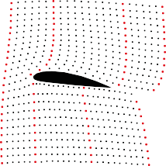

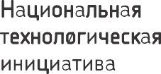










OUR PARTNERS
WEB PAGE
CO P T E R E X P R E S S . CO M

Slide 5
INTEGRATED CONSECUTIVE ANSWER TO CHALLENGES CAUSED BY EPIDEMICS USING DRONES for:
What we suggest
• Monitoring&express diagnostics
• Data collection for further analysis (real-time mapping of disease spread)
• Informing population of safety precautions as well as first steps in case of suspected diagnosis (nearest hospital location, special services for patients)
• Calling medical team
• Further care for patients/quarantined (obtaining tests, providing food&product delivery)

Slide 6
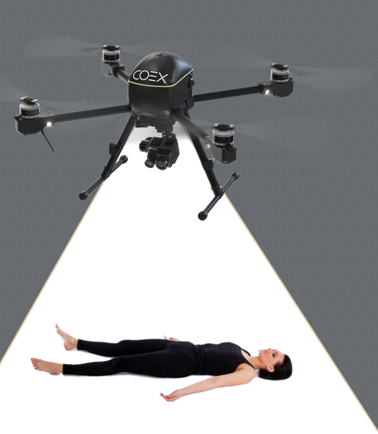
MOTIVATION FOR PARTICIPATION IN HACKATHON
Our immediate aim is to encourage greater audience to create projects
We will build temperature analyzing drone as a direct response to goals set
Our long-term goal is to find partners passionate about developing technologies to boost progress and social security internationally
STEM|College|UNIVERSITY
Investments
Online educational platform development
Big data analyzing
Competition organizing

Slide 7
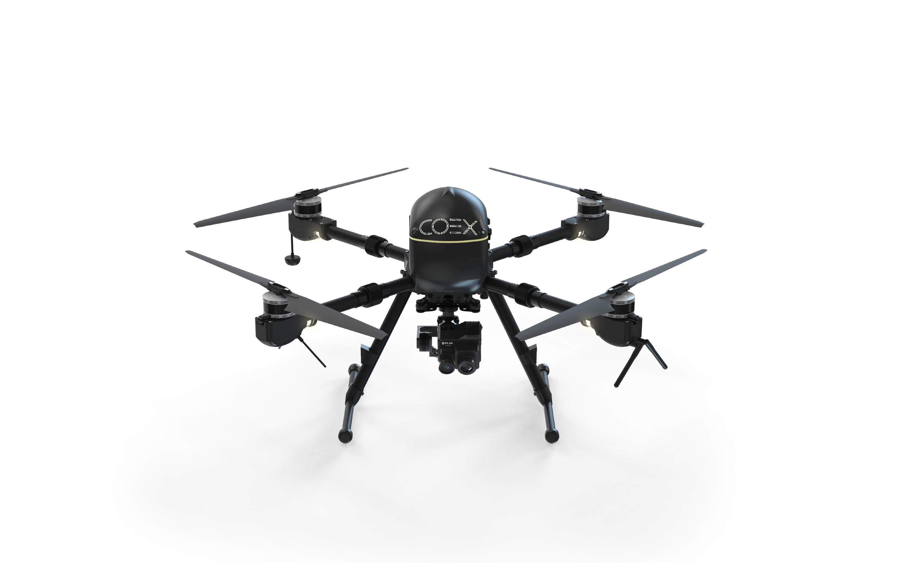
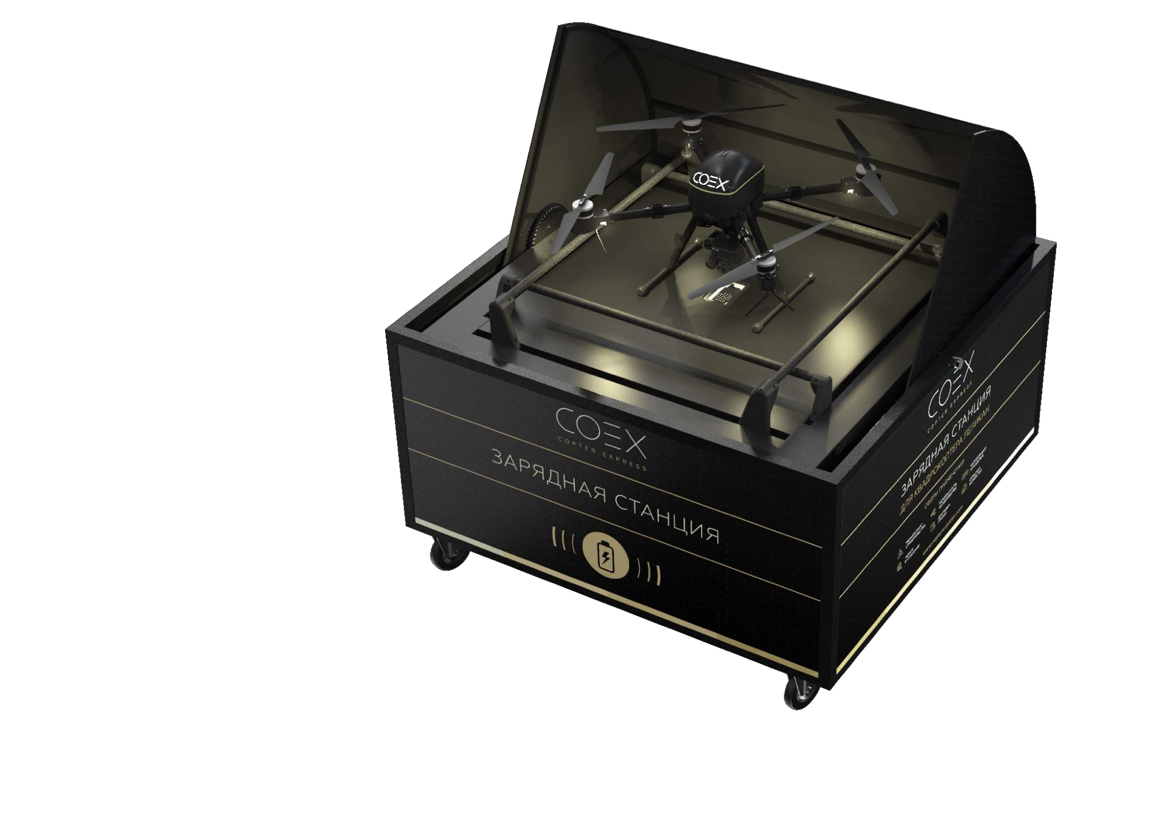
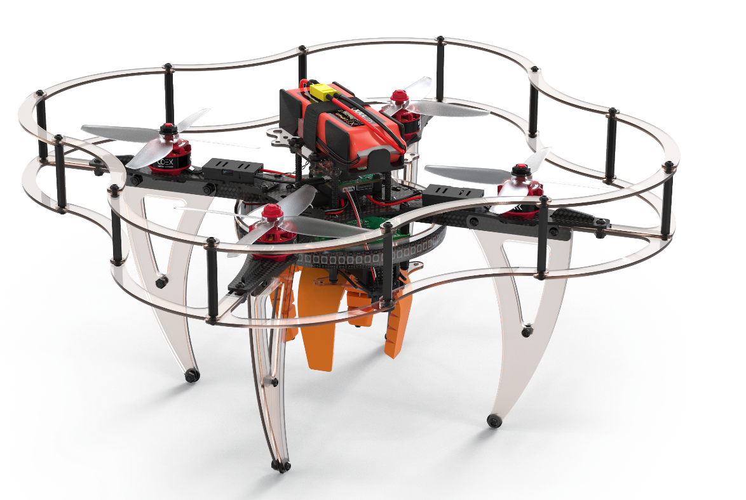


Drone Ecosystem Technologies already exist – let’s build working ecosystem of day-to-day services together!
WEB PAGE
COEX.TECH
Clover
Pelican
(monitoring, cargo delivery)
Charging station
(STEAM education)

Slide 8

TERRITORY COVERAGE
OF ANY AREA WITH CHARGIN STATION
WEB PAGE
CO P T E R E X P R E S S . CO M

Slide 9
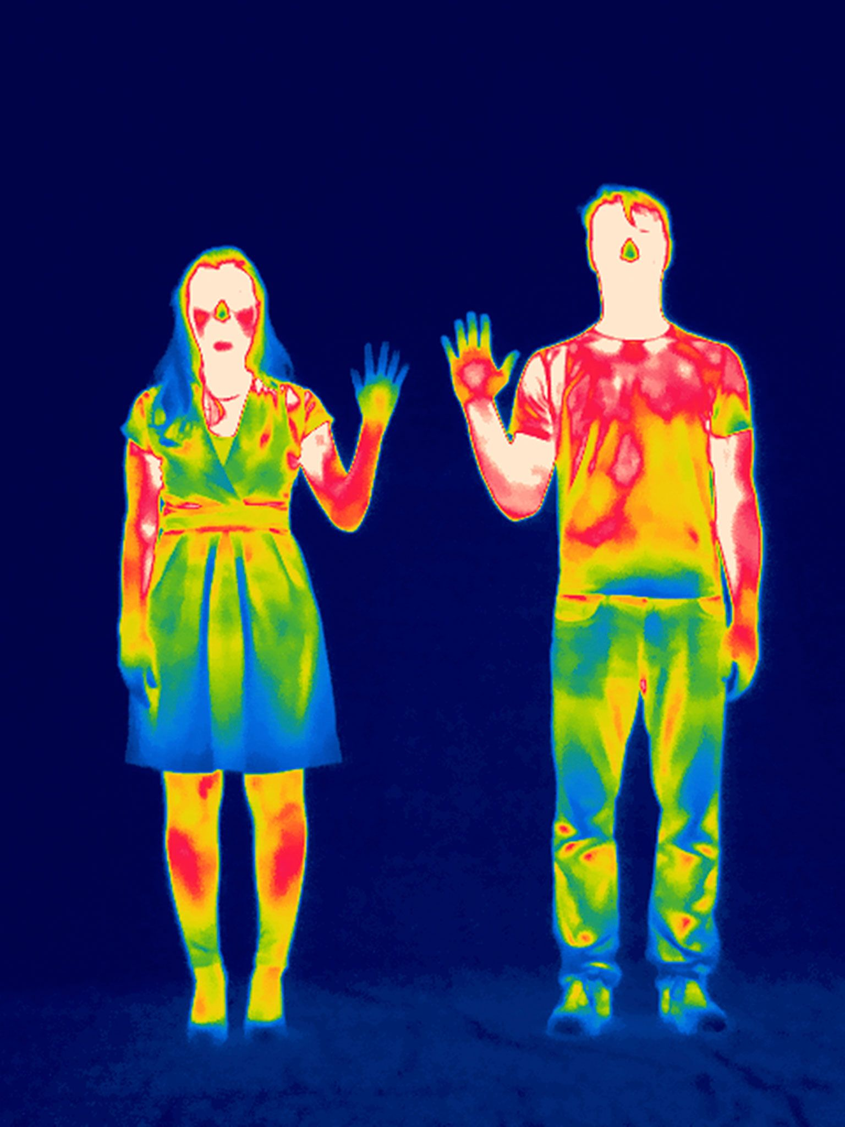
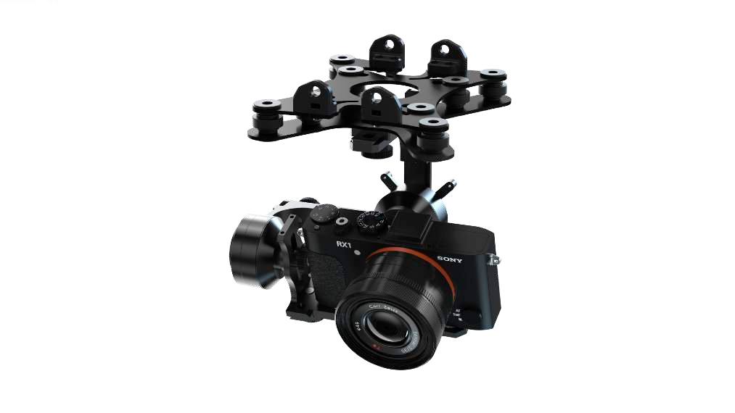
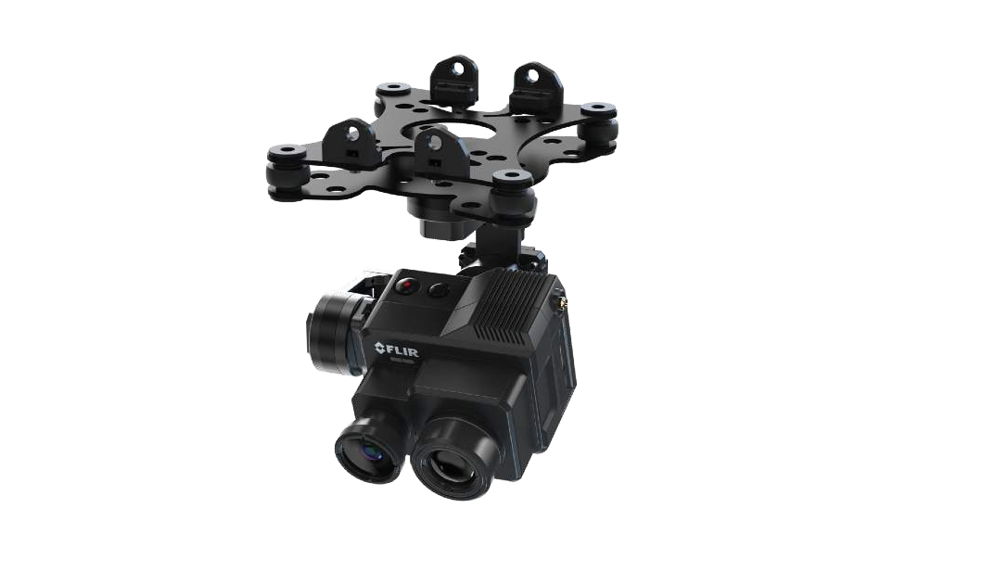
Aerial survey
WEB PAGE
CO P T E R E X P R E S S . CO M
Thermal camera Monitoring
Drones allow to quickly cover large distances, providing equipment where needed and fast data transfer over 5G networks

Slide 10
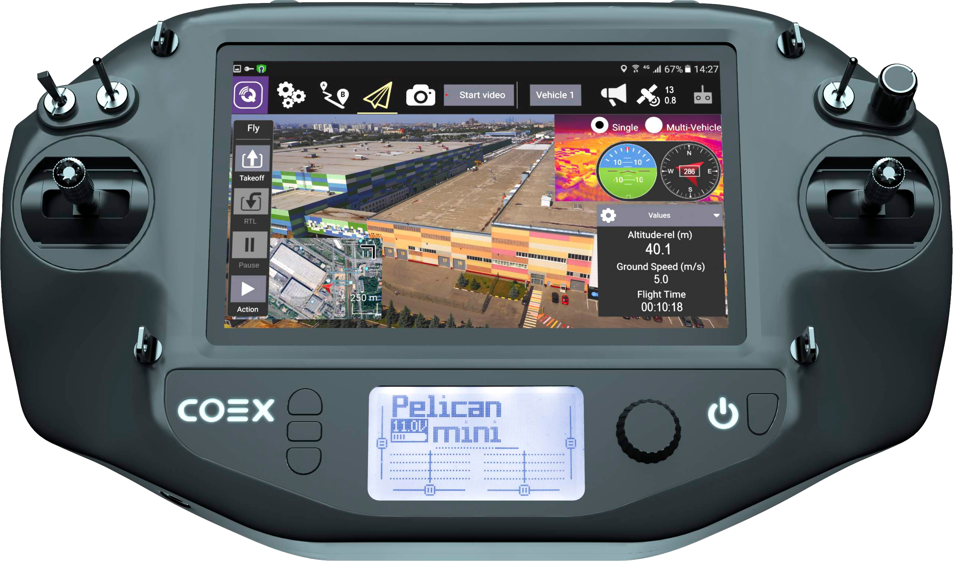
GROUND STATION AND CONTROLS
Operators receive data in real time

Slide 11
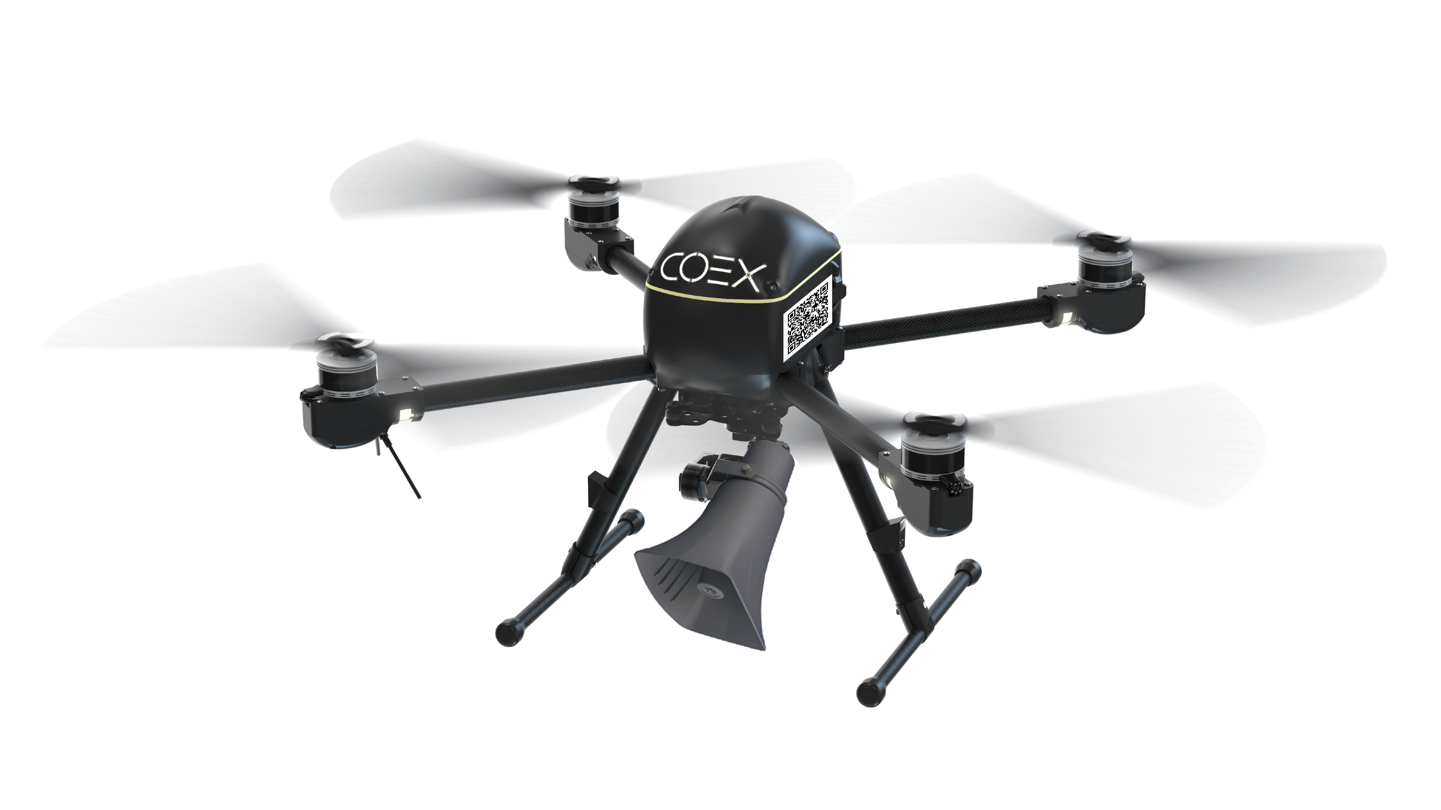
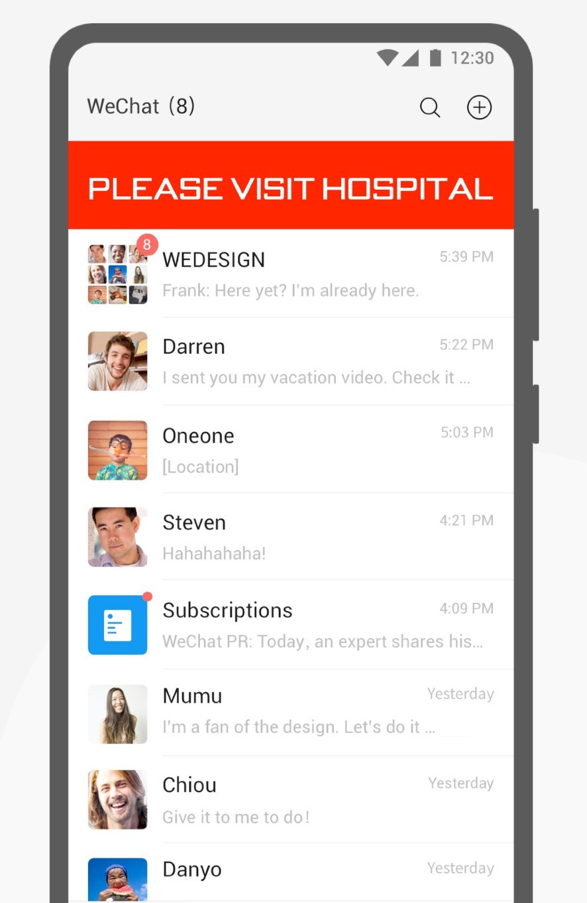

INFORMING FUNCTION
After performing temperature check, system can send notifications to citizens using facial recognition
Informing population of safety precautions as well as first steps in case of suspected diagnosis (nearest hospital location, special services for patients)

Slide 12
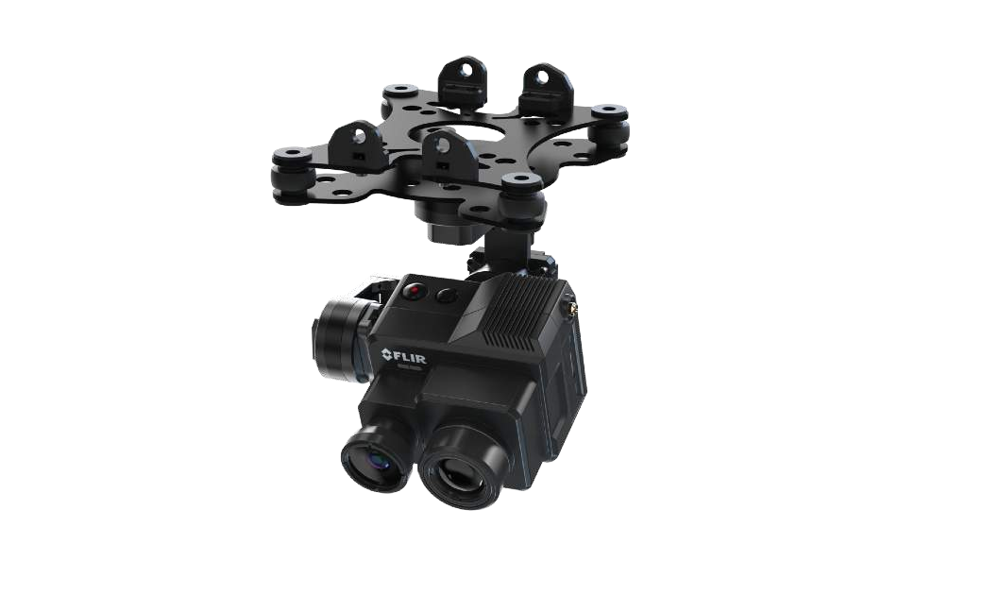
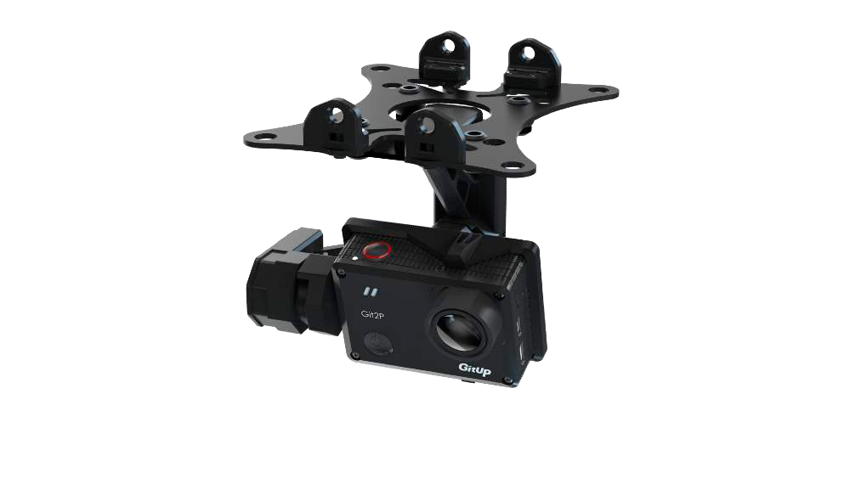
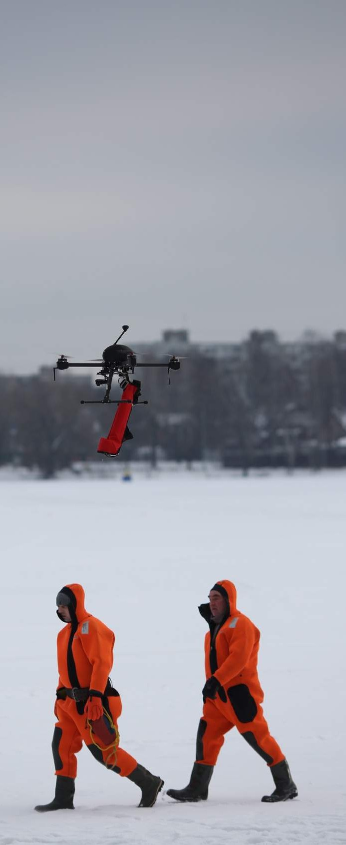
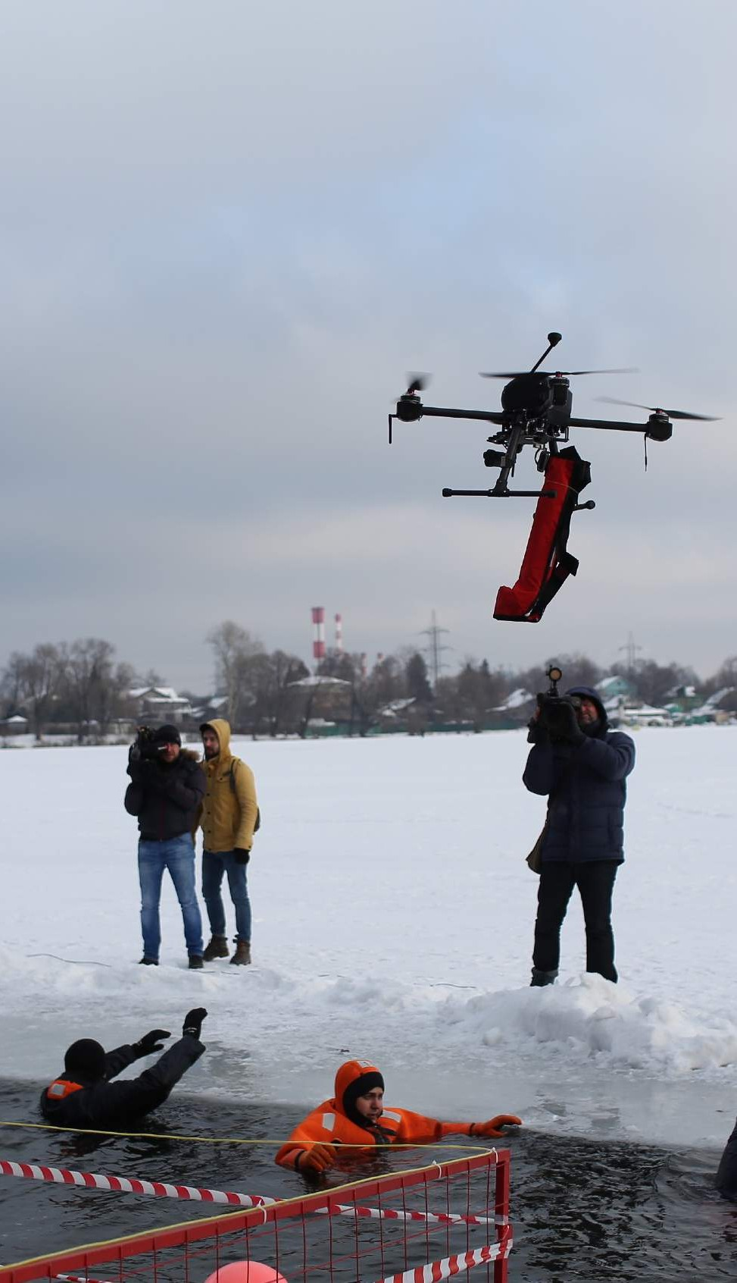
SEARCH AND RESCUE
WEB PAGE
CO P T E R E X P R E S S . CO M
Thermal camera, Monitoring
Location aerial monitoring
Video recording near emergency areas
Assessment and analysis of the situation and decision making
Coordination of emergency services actions

Slide 13
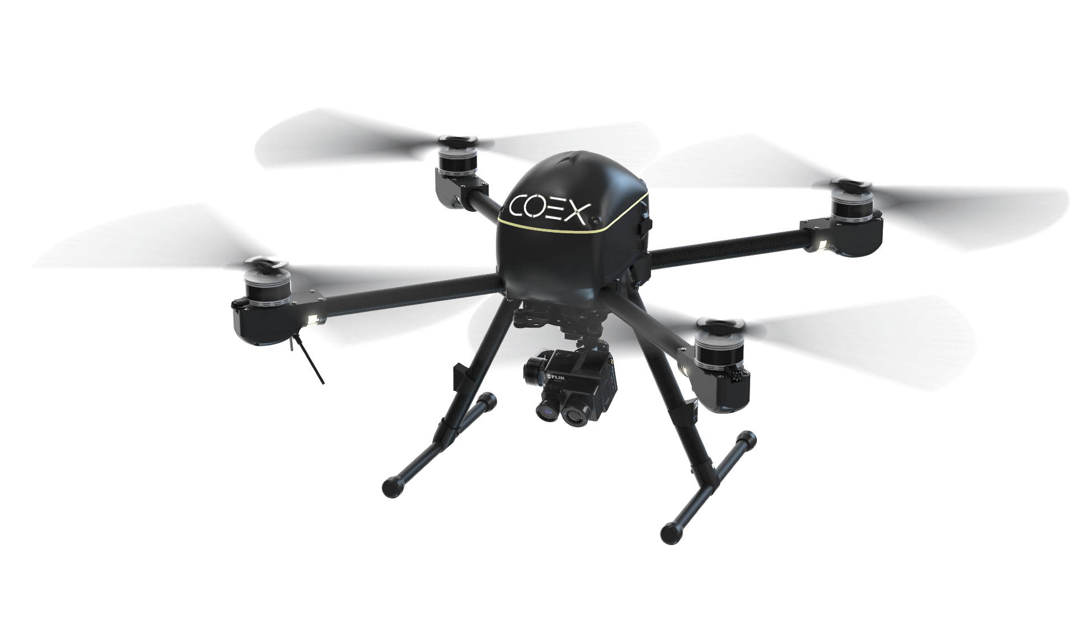
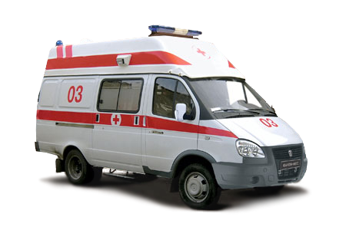
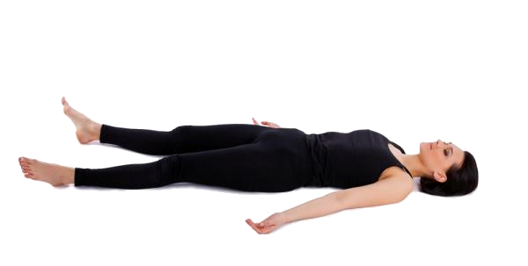
CALLING MEDICAL TEAM

Slide 14
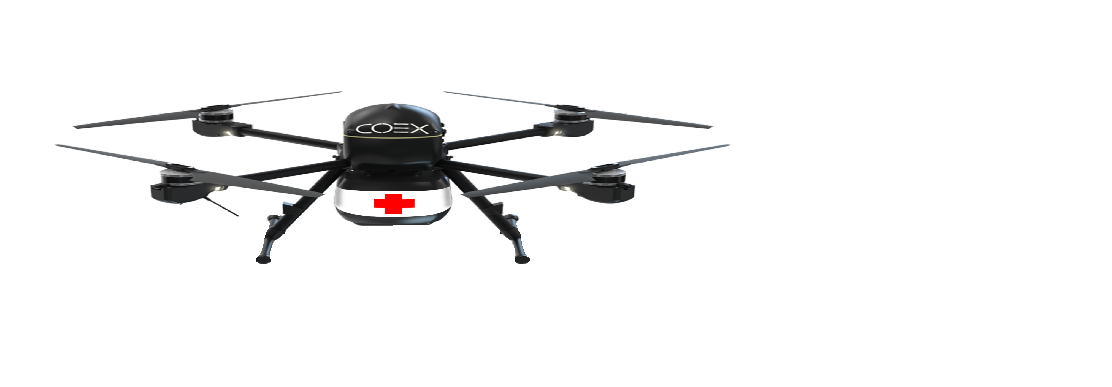
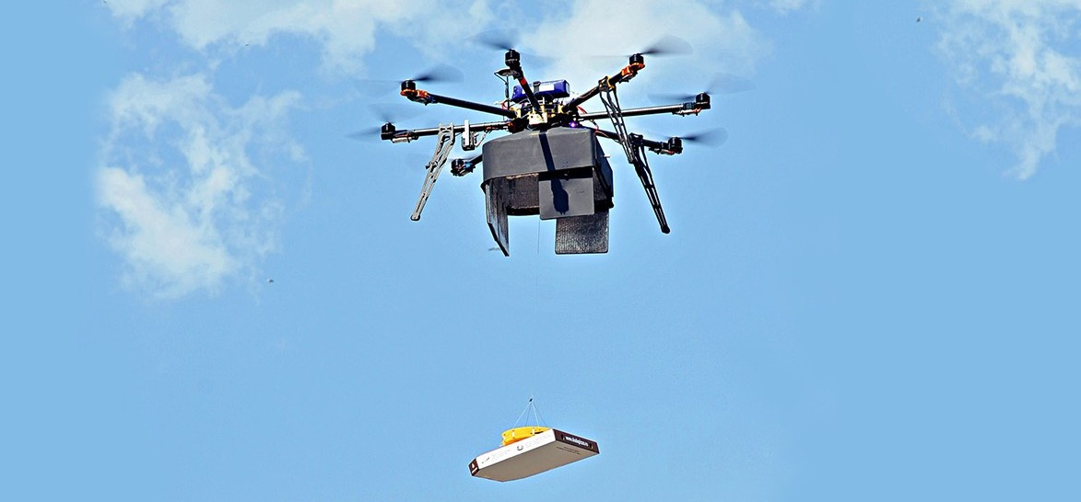
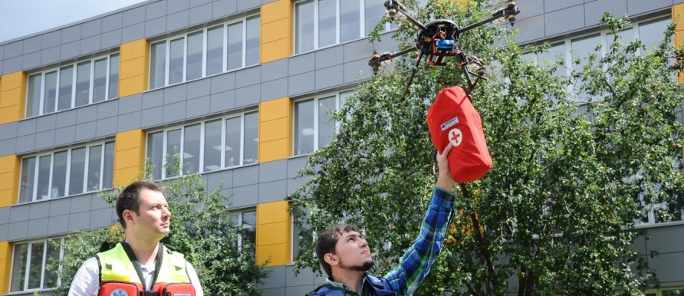
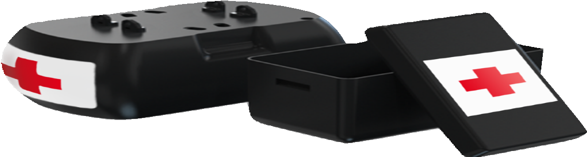
FURTHER CARE
FOR PATIENTS/QUARANTINED
Delivering medical tests and drugs quickly

Slide 15
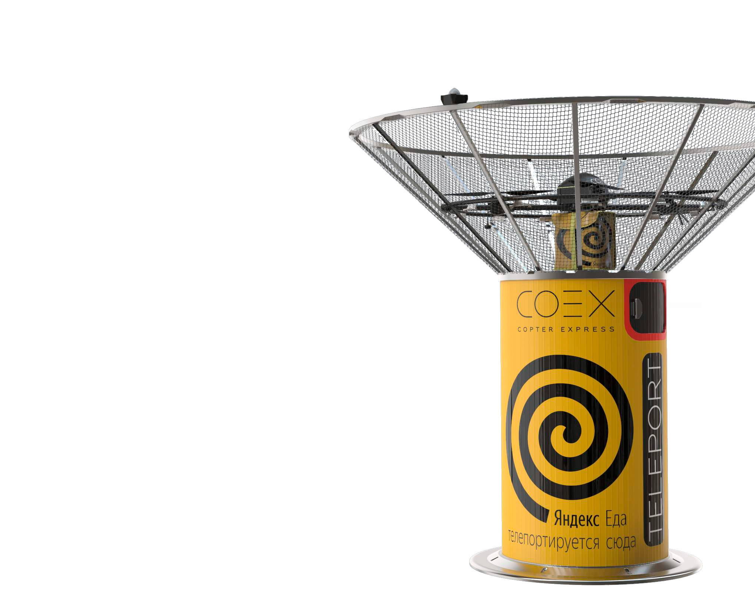
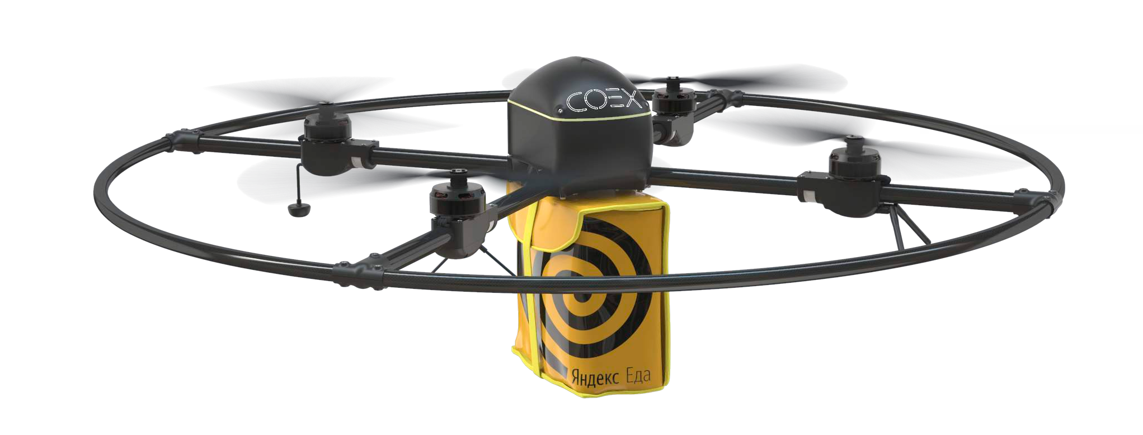

Cargo & Food delivery
WEB PAGE
COEX.TECH
COEX TELEPORT

Slide 16


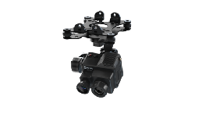
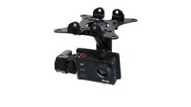

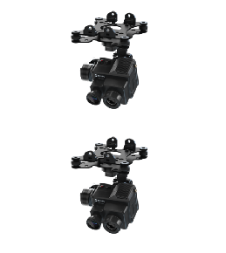
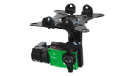
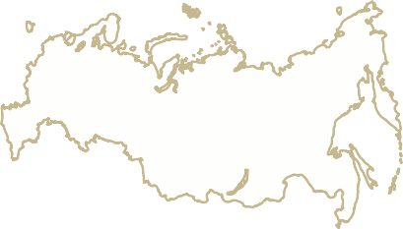
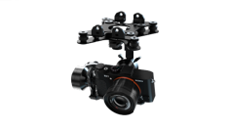

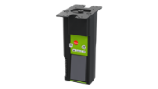
APPLICATION
WEB PAGE
CO P T E R E X P R E S S . CO M
Aerial monitoring of the territory
Performing photography in the emergency area,
Assessment and analysis of the situation and decision making,
Coordination of actions of rescue services
Search and rescue missions
Thermal Imager, video monitoring
aerial monitoring of forests during the fire- dangerous period
shooting in the area of floods and fires
detection of burning peat production areas
Monitoring of forest fires
and floodings
Thermal Imager, aerial photography
real time monitoring of non-supervised borders in all weather conditions
collection and transfer of information on the territory between protected areas
Security of state borders
Thermal Imager, video monitoring
Security of movable and immovable objects
Thermal Imager, video monitoring
Monitoring while hovering above the objects or people
Increased level of security of the object
Medication delivery in emergency areas and cargos on guarded premises
Medical kits and life vest delivery to emergency areas
Small-size cargo and documents delivery
Cargo container
Thermal Imager, methane detector
Methane leak detection
Inspect gas pipelines in difficult conditions
Monitoring on the territory of plants
Oil and gas industry

Slide 17
IMPLEMENTATION REQUIREMENTS:
• Designing adequate ecosystem of drones and day-to-day services they provide
• Building control platform of distributed drone swarm
• Providing high uptime and maintenance
• Services and API for analyzing data gathered and injecting POI (such as hospitals, food stores, drug stores)
• Building drone-human interaction instruments
• Adopting aerial control legislation
• D
All this will in turn require developing professional training system

Slide 18


Slide 19
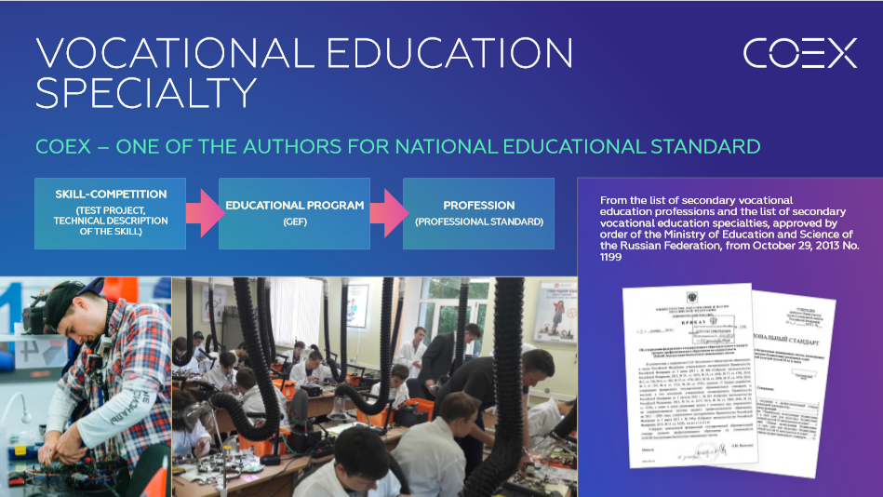

Slide 20


Slide 21
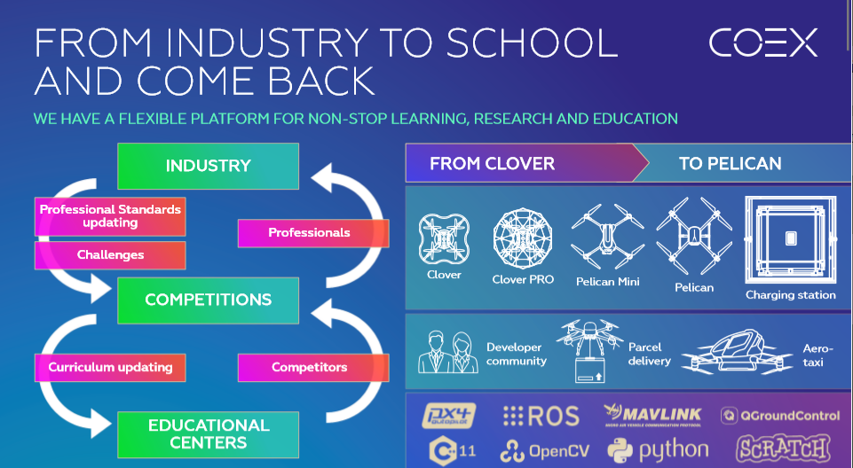

Slide 22
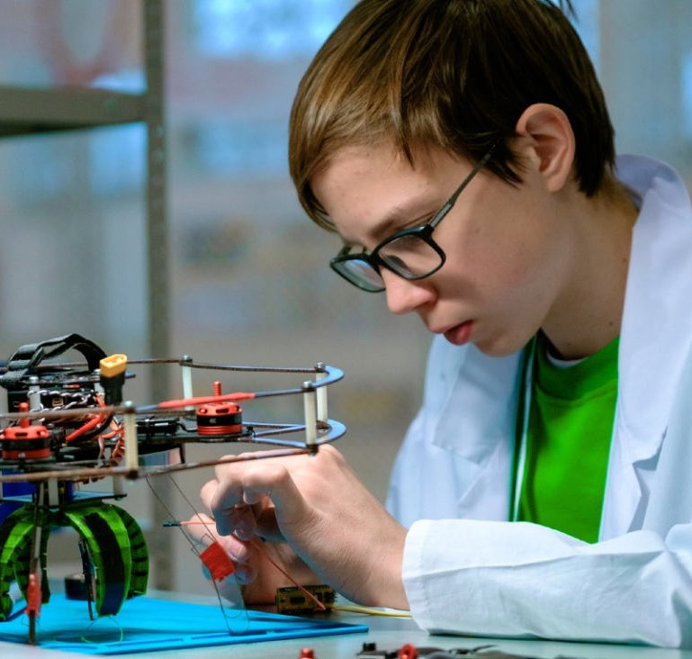
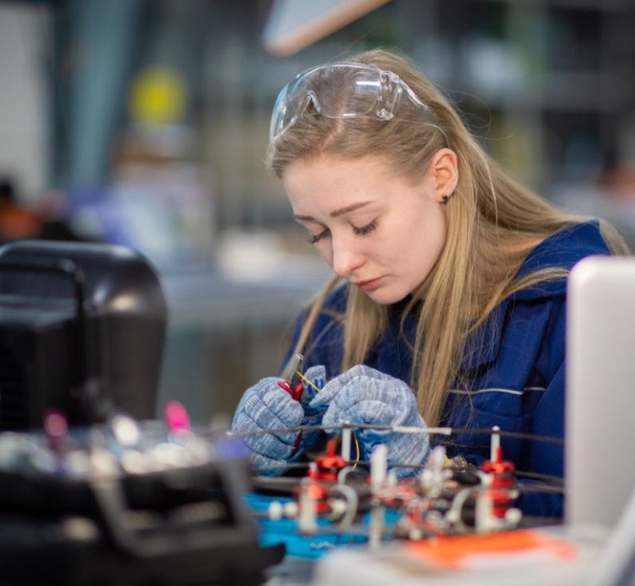
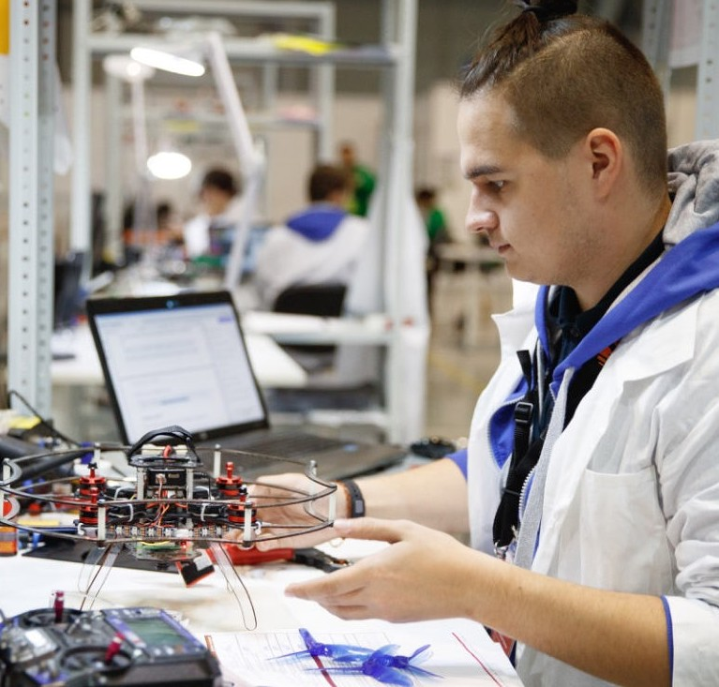

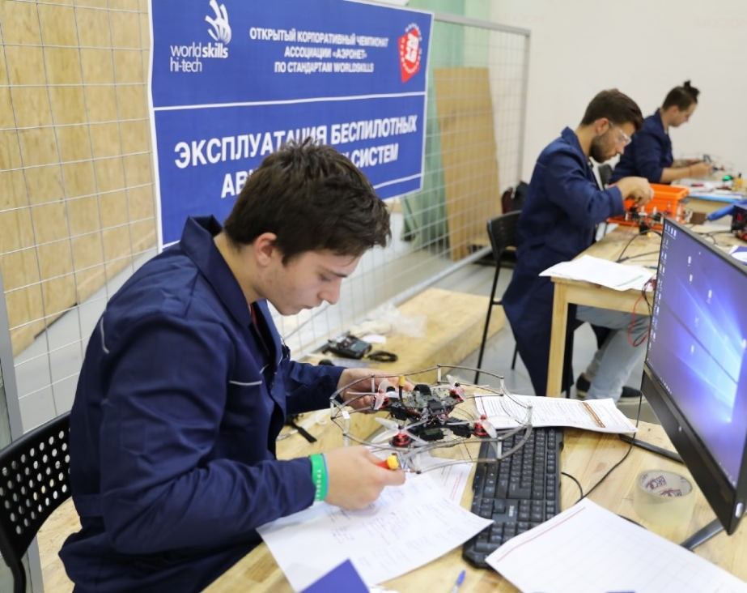
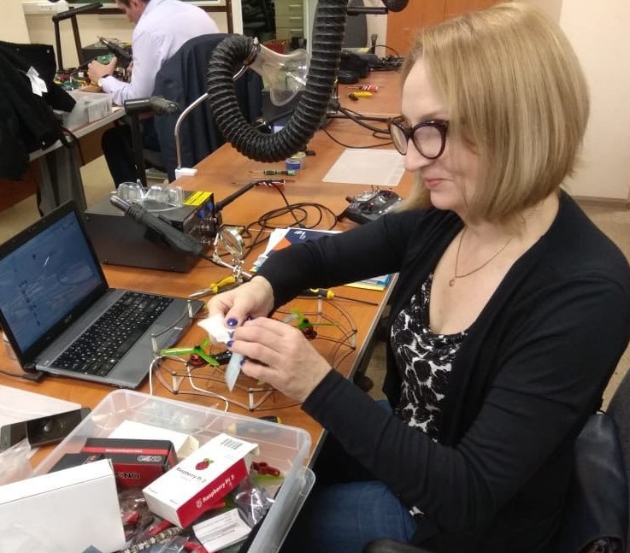










AGE CATEGORIES AND COMPETITIONS
IN WORLDSKILLS COMPETITIONS « DRONE OPERATING»
WorldSkills Juniors
12-14 years / 14-16 years
(school students)
TVET students –
National Competition
16-22 years old
(college students)
University League
17-35 years old
(university students)
Hi-Tech
17-49 years
(young specialists)
SeniorSkills 50+ years (retraining)

Slide 23
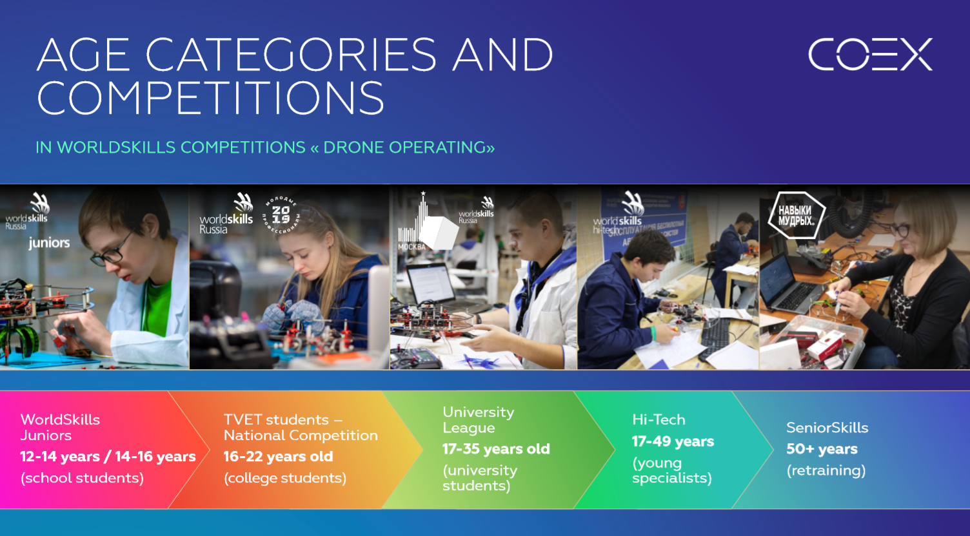

Slide 24
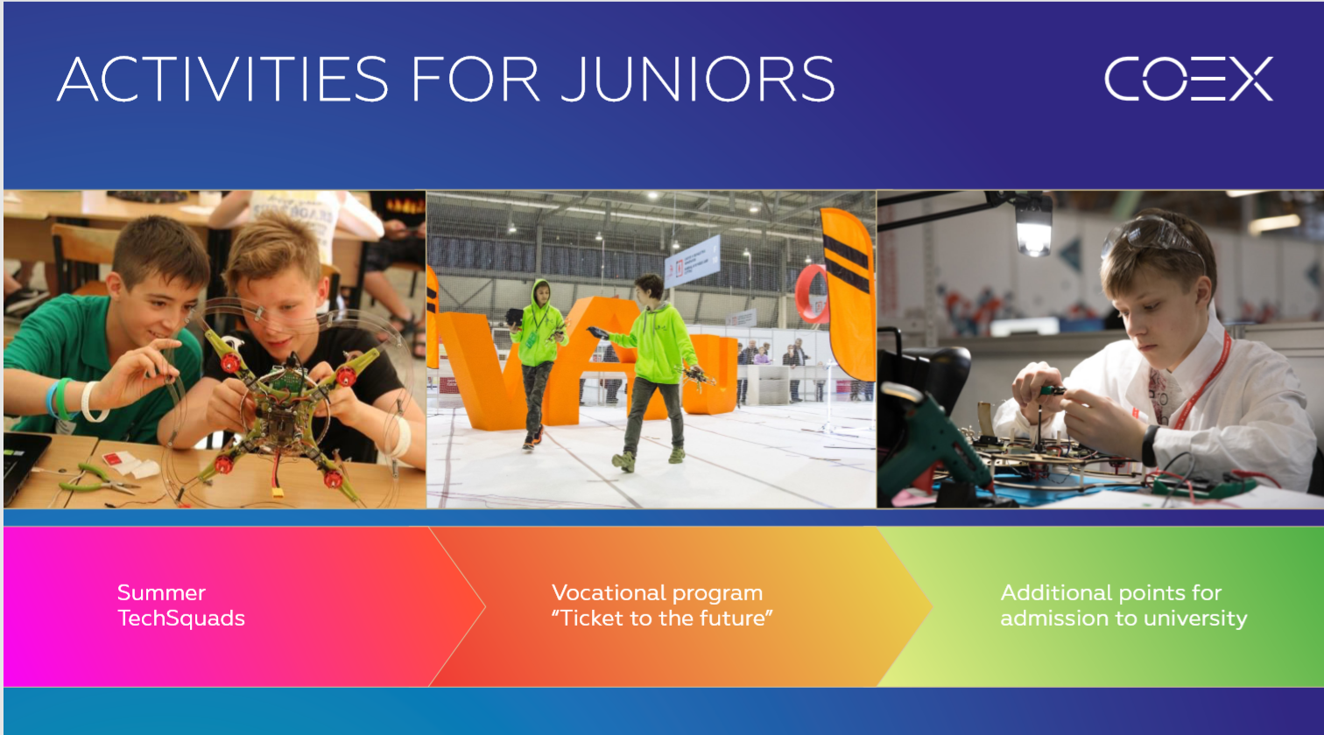

Slide 25
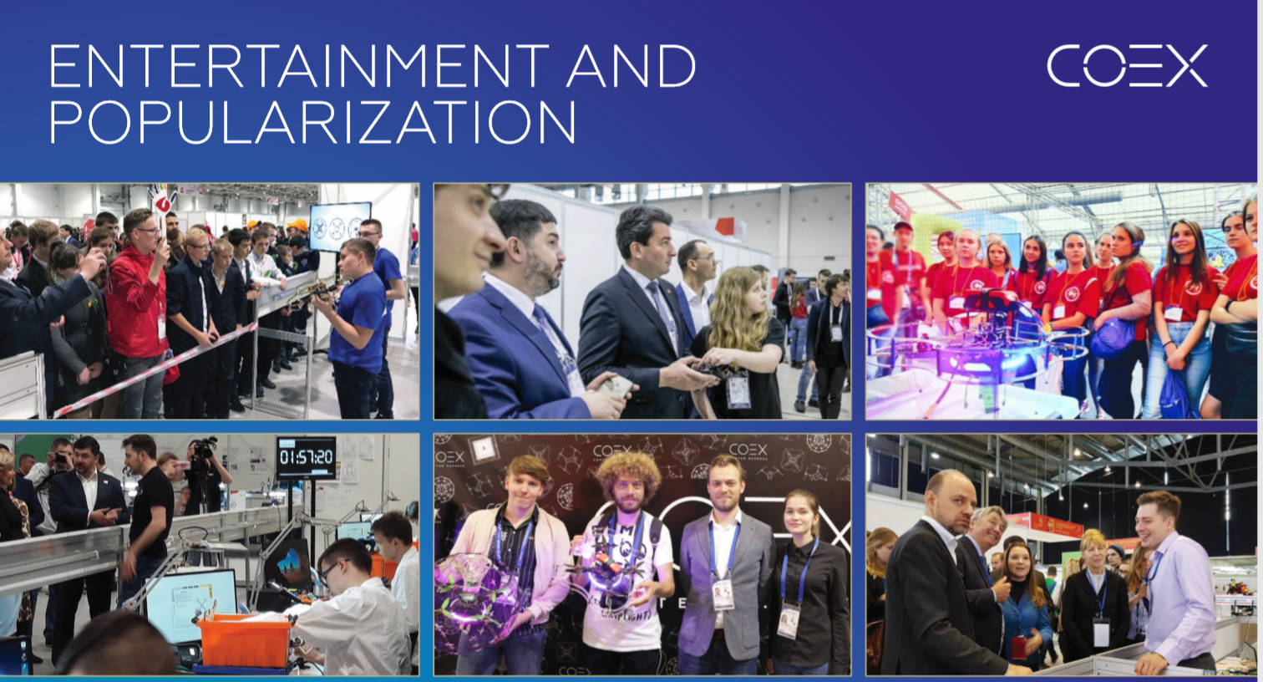

Slide 26
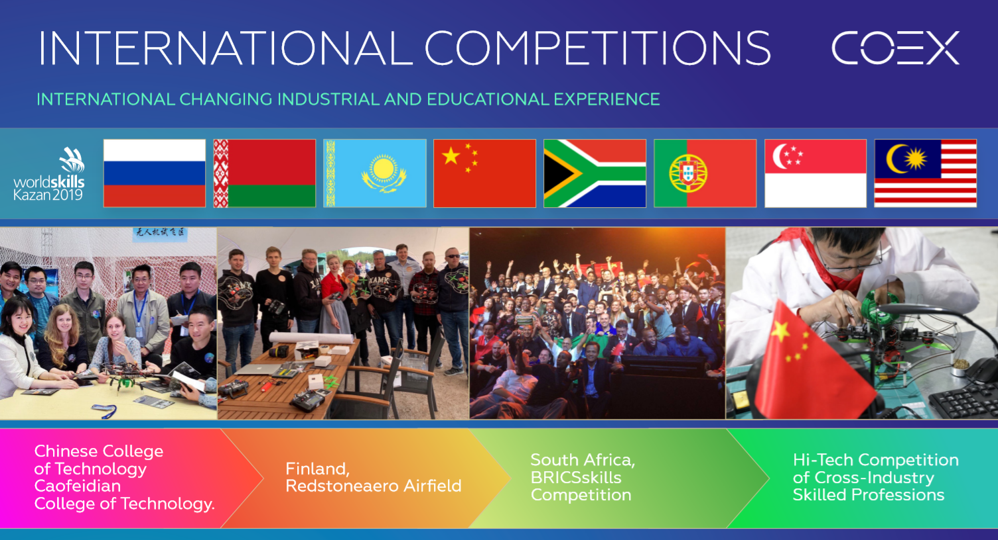

Slide 27
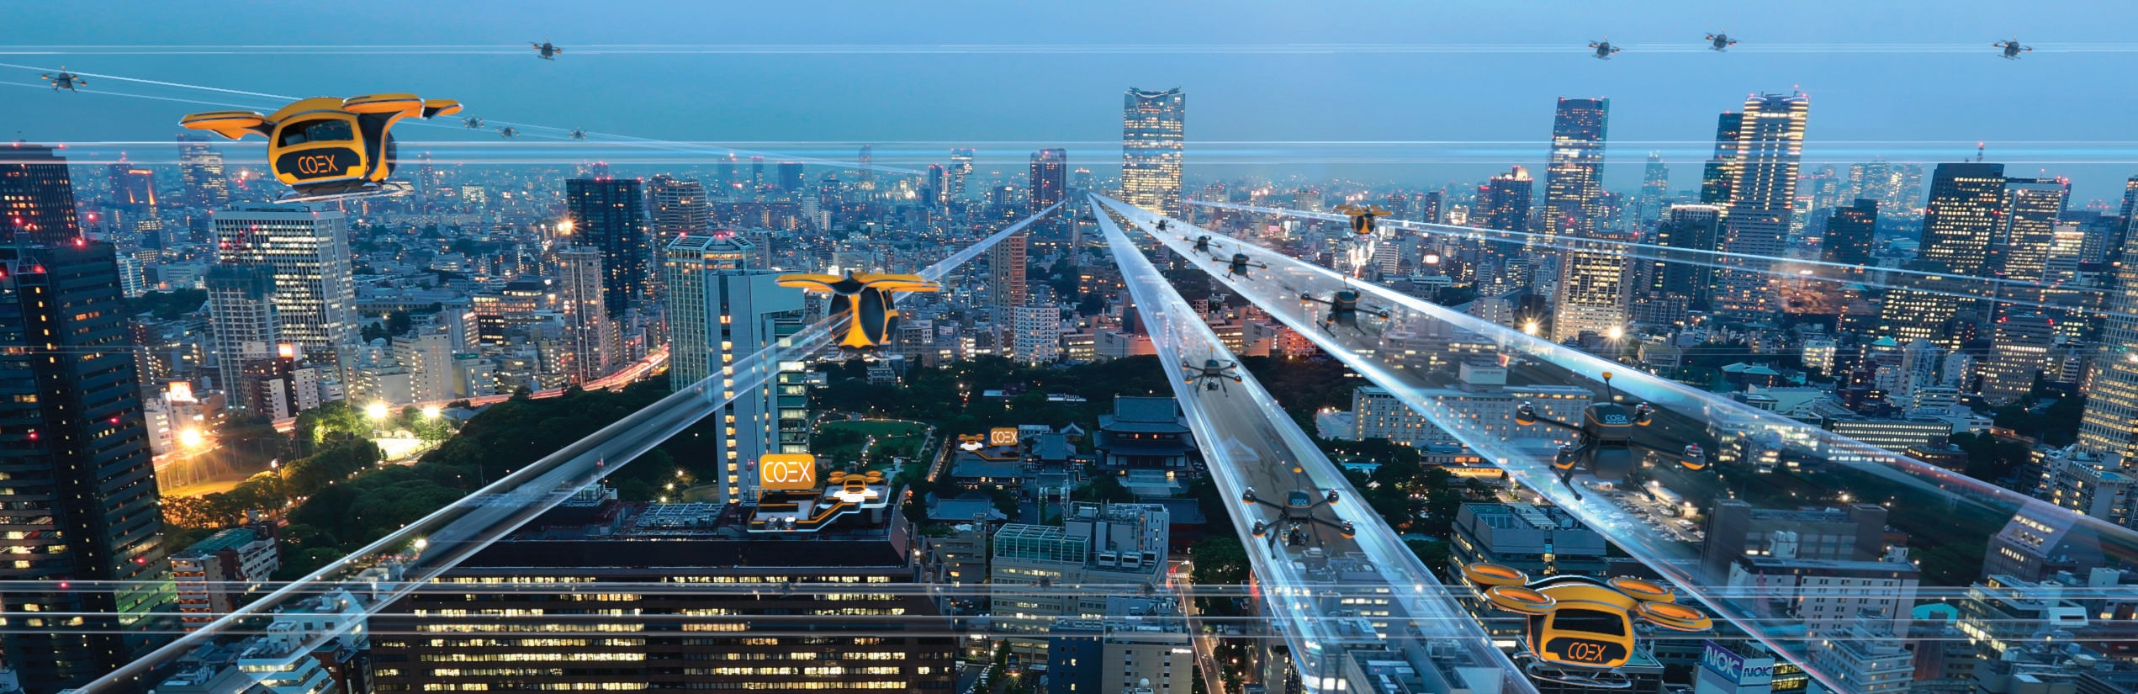
VISION OF THE FUTURE
WEB PAGE
CO P T E R E X P R E S S . CO M

